Slide 1
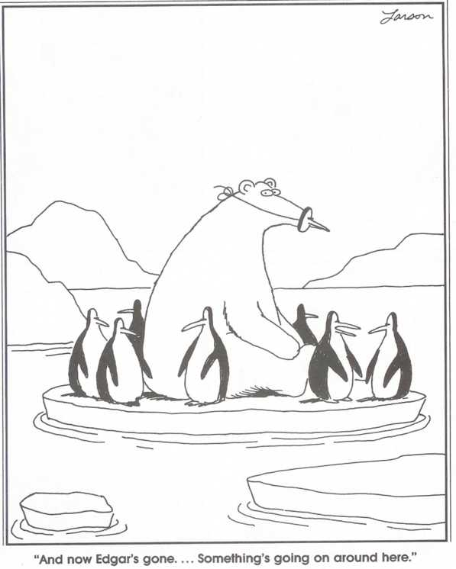
D
A
M
N
I
T
!
F
O
C
U
S

Slide 2
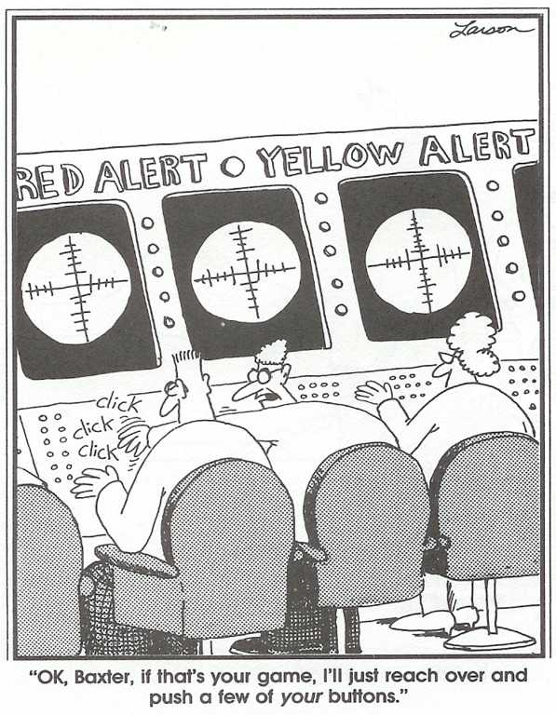
Notes:
This is not how things actually work at HQ NORAD – there’s no one at all actually named Baxter!
As a naval officer, I am constantly aware that control of the Electro-Magnetic spectrum is vital to success in modern warfare. Here is what can happen if you lose that control……

Slide 3
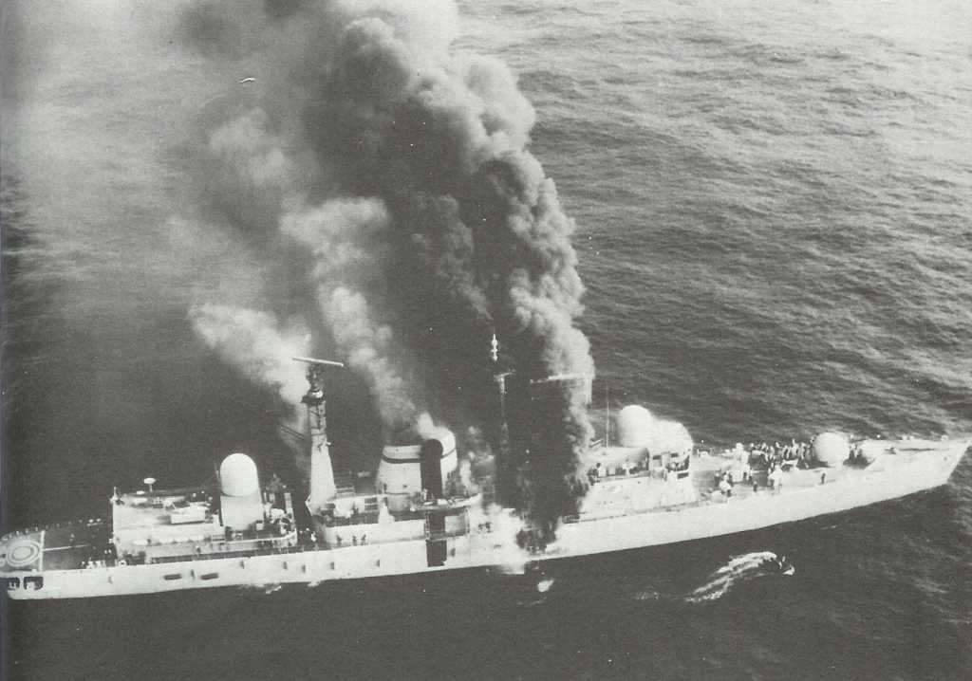
Notes:
HMS Sheffield, struck by an Argentine Exocet missile on 4 May 1982 during the Falklands War. Reportedly, the missile’s radar homing head was not detected by the ship’s radar intercept receivers as they were de-sensed by the satellite communication equipment being used to communicate with headquarters in the UK.
The missile struck amidships. Although there is reason to believe that the warhead did not explode, the missile still contained a great deal of fuel, having been launched at a range of only 12 miles. The resulting fires spread dense smoke throughout the ship, making damage control measures very difficult. Four hours later the ship was abandoned. It sank while under tow 6 days later. Twenty men were killed.

Slide 4
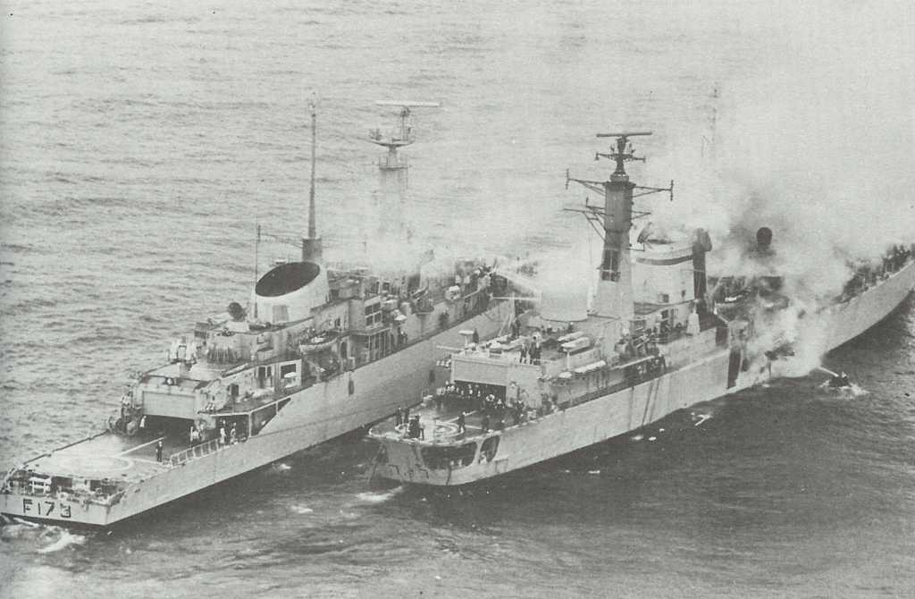
Notes:
HMS Arrow coming alongside the Sheffield in an effort to extinguish the flames. Note the small boat equipped with a portable fire pump on Sheffield’s starboard side. Note also the electronic intercept antennas on Sheffield’s mainmast.
When rescued from their liferafts, the crew were singing “Always Look on the Bright Side of Life”, from Monty Python’s movie “The Life of Brian”!

Slide 5
Electronic Warfare (EW)
Military Action involving the use of Electro-
Magnetic energy to Determine, Exploit, Reduce,
or prevent hostile use of the EM Spectrum,
and action which retains friendly use of the
EM Spectrum.

Slide 6
Electronic Support Measures
(ESM)
That part of EW involving actions taken to
search for, intercept, locate and identify
radiated EM energy in order to detect, identify
and localize threats.

Slide 7
Electronic Counter-Measures
(ECM)
That part of EW involving actions taken to
prevent or reduce an enemy’s effective use
of the EM spectrum.

Slide 8
Electronic Counter-Counter-
Measures (ECCM)
That part of EW involving actions taken to
retain friendly use of the EM spectrum despite
an enemy’s use of ECM.

Slide 9
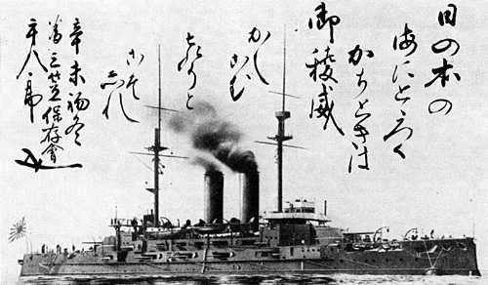
Russo-Japanese War, 1904 - 1905
Notes:
The first recorded example of Electronic Warfare being used in a conflict occurred during the Russo-Japanese War of 1904/05. On March 8, 1904, the Japanese navy attempted to shell Russian warships anchored in Port Arthur, on Russia’s East coast. Two armoured cruisers were sent to conduct an indirect bombardment, using a destroyer favourably located near the coast to observe the fall of shot. Corrections for the gun crews were to be sent from the destroyer to the cruisers using wireless.
However, a wireless operator at the Russian base overheard the exchange of signals between the Japanese vessels, and instinctively keyed his own spark transmitter. With their communications link jammed, the Japanese force withdrew, and no Russian ships were lost that day (although plenty would be sunk in the Battle of Tsushima!)
Photo shows the Japanese flagship Mikasa, and the signal transmitted by Admiral Togo to his ships. In the spirit of Nelson’s signal before Trafalgar,
it read "The rise and fall of the Empire depends upon this battle. Every man is expected to do his utmost."

Slide 10
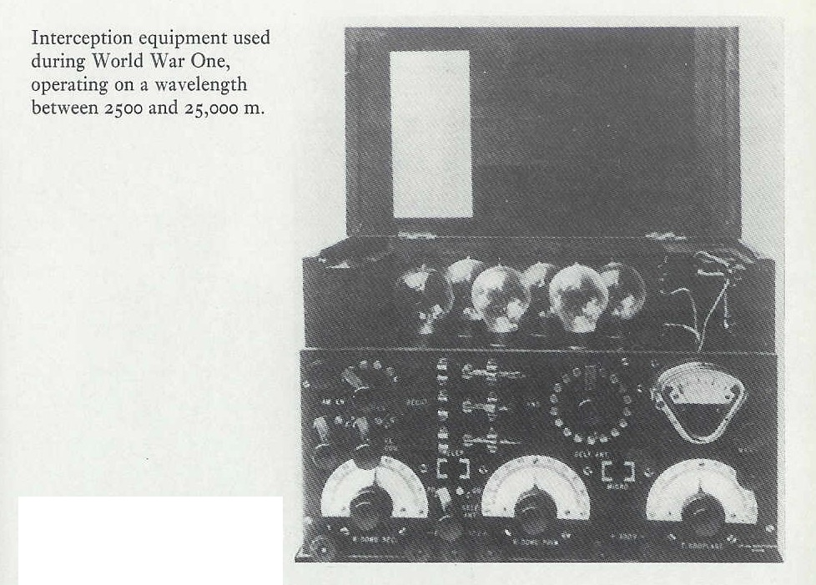
Notes:
Further advances in what became known as Electronic warfare were made during the First World War, primarily in the fields of Radio Direction Finding and signal intelligence. The sailing of the Royal Navy’s Home Fleet before the Battle of Jutland, for example, was initiated by the interception of German transmissions that indicated the German High Seas Fleet was preparing to leave port. By the end of the war, the Royal Navy had an extensive chain of RDF stations covering the North Sea.

Slide 11
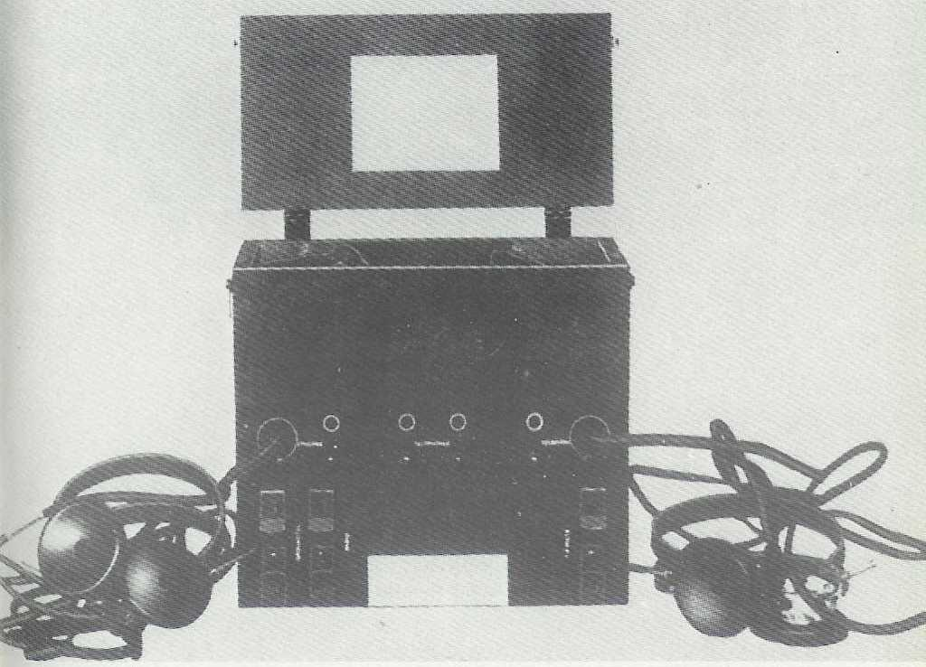
Notes:
Equipment used to intercept field telephone communications. Two ground rods spaced far apart could detect the faint ground current used to complete the circuit. Suitably amplified, the conversation could be overheard.
The art of radio and electronics matured between the wars, but it was not until World War Two that Electronic Warfare came into its own as a major consideration. It is this “Wizard War”, as Sir Winston Churchill called it, that I will speak about today. I have selected the first major episode involving the use of EW from WWII. That was……

Slide 12
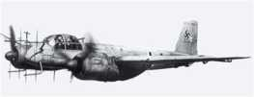

The BATTLE of the
BEAMS
March 1940 – May 1941
Al Penney, VO1NO
Notes:
The Battle of the Beams, March 1940 to May 1941.

Slide 13
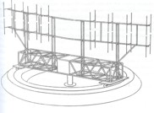
Instruments of Darkness Alfred Price
Electronic Warfare Mario de Arcangells
Most Secret War R. V. Jones
The Secret War Brian Johnson
Night Fighters Bill Gunston
Notes:
My references…

Slide 14
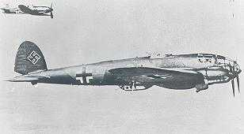
Luftwaffe Heinkel 111 bomber
Notes:
In early 1940, while the “Phony War” was fought by troops comfortably entrenched on either side of the Maginot Line, single Luftwaffe night bombers began probing the almost non-existent night defences over the blacked-out towns and cities of Britain. In March however, a British night fighter, guided by ground based radar, managed to intercept a Heinkel 111 of Bomber Group 26 and shoot it down. Later that day as its wreckage was being inspected by RAF intelligence officers, they discovered a note used by the navigator. It mentioned a radio beacon “knickebein”, German for “crooked leg”, on a bearing of 315. This was the first time the intelligence officers had encountered the term.

Slide 15
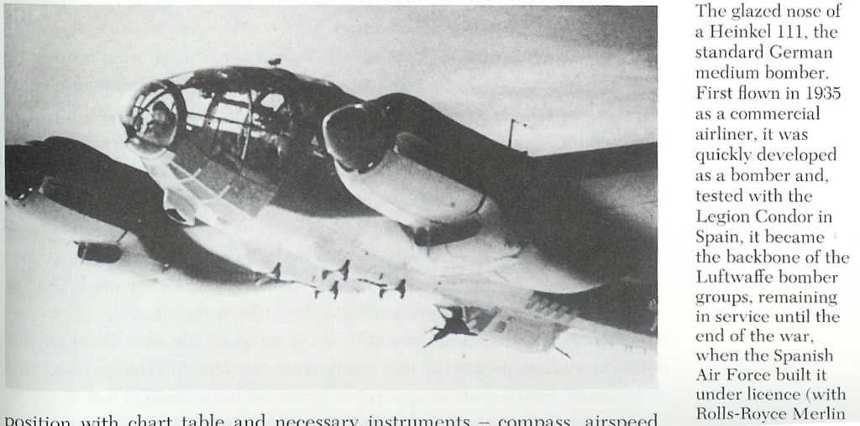
Notes:
Another view of the Heinkel 111. Note the glazed nose – the bombardier must have felt very vulnerable!
Several days later a diary was recovered from another Heinkel, coincidentally bearing the same markings as the first. It too mentioned Knickebein. With this codeword in mind, RAF Intelligence decided to see if it would elicit any response from Luftwaffe Prisoners of War. One cooperative prisoner admitted that it was similar to X-Gerat, assuming that the British were familiar with both systems, and that it was a beam so narrow that two of them could pinpoint a target with an accuracy of less than one kilometer.

Slide 16
See notes
Notes:
X-Gerat, or “Secret Apparatus”, was know by RAF Intelligence to be a system of intersecting radio beams used to guide bombers. They first got wind of it in an anomymous letter dropped off for the British Naval Attache in Oslo Norway on 4 November 1939. Nicknamed the Oslo Report, it outlined the extent of German research into new weapon systems, including radar, proximity fuses, magnetic mines, and the V1 and V2 rockets then under development at Peenemunde. The British first believed it to be a Nazi attempt at disinformation – no one person could have such detailed knowledge of so many secret projects. In the words of Dr. Reginald V. Jones, a young physicist appointed as Scientific Officer to the Military Intelligence Service (MI6), “… as the war progressed and one development after another actually appeared, it was obvious that the report was largely correct; and in the few dull moments of the war I used to look up the Oslo report to see what should be coming along next”.
The author of the Oslo Report remained anonymous until 1989, when he was identified as German physicist Hans Mayer in the book Reflections on Intelligence, by Jones.

Slide 17
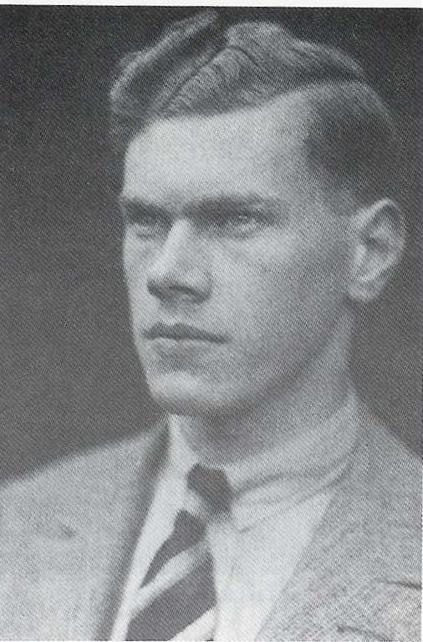
Dr. Reginald V. Jones 1911 – 1997
Commissioned in Officer Training Corps 1928
PhD in Physics 1934
Assistant Director of Scientific intelligence 1939
Outstanding work in all aspects of Scientific Intelligence.
Professor Emeritus
“Most Secret War” published as “The Wizard War” in United States
Notes:
As Jones figures quite prominently in our story, an introduction is in order.
Reginald Victor Jones was born in London in 1911, the son of a career officer in the Grenadier Guards. As a boy he built many crystal radios, and in 1928 built a “thermonic valve” radio to receive a test transmission from Australia, receiving a QSL card in confirmation. He entered the Officer Training Corps and was commissioned in 1928. He received his doctorate in physics in 1934 at the age of 22. In the 1930s he worked on Infra-Red detection of aircraft, and at the start of the war he was appointed Assistant Director of Scientific Intelligence at the British Air Ministry.
In addition to his work with the Battle of the Beams, he discovered the tactical and technical details of the German radar-controlled night defences, correctly analyzed intelligence on V1 and V2 rockets, and conceived of chaff, the most widely used method to jam and deceive radar. In 1946 he was appointed Director of Scientific Intelligence, and later Chair of Natural Philosophy at the University of Aberdeen. He was described as a superb lecturer, interesting and amusing, and a great practical joker. He retired as a professor emeritus in 1981, and passed away in 1997 at age 86.
His awards include CBE 1942, CB 1945, US Medal for Merit and the US Medal for Freedom, honourary member of the USAF, and he was the 1st foreigner ever to speak in the CIA auditorium. In 1993 the CIA created an award in his name, and CIA Director James Woolsey described him as a “one-man, all source intelligence evaluation, collection and analysis section”. In 1994 he was appointed “Companion of Honour”, one of Britain’s highest awards, and it was declared “a national scandal” that his wartime work was not honoured with a knighthood. His book Most Secret War was published as The Wizard War in the United States.

Slide 18
See notes
Notes:
To Jones fell the task of assessing the capabilities of this German navigation aid. Any system of intersecting radio beams that enabled a bomber to locate a target to within a kilometer had to operate on high frequencies. But how could the Germans generate enough power at those frequencies? More puzzling, how could radio waves at those frequencies travel around the curvature of the Earth? Here Jones was assisted by Rowley Scott-Farnie, G5FI, a signals officer in RAF Intelligence. He showed Jones a report by T. L. Eckersley, chief engineer with the BBC and the country’s leading propagation expert. Eckersley’s calculations indicated that a 20 cm signal would bend around the Earth from Germany, and could be received by a bomber over London at 20,000 feet. This information, and the intelligence that had already been collected, prompted Jones to alert Professor Lindemann that the Luftwaffe had a system for accurate night-time bombing. Lindemann was scientific advisor to Prime Minister Winston Churchill. He was sceptical until Jones produced Eckersley’s report.
But how were the Germans doing it? Examinations of crashed German aircraft revealed nothing out of the ordinary – certainly nothing in the way of centimetric receivers. Jones reviewed all the available information, especially the results of interrogations of captured Luftwaffe aircrews. He learned that one pilot had been overheard to brag to another that no matter how hard the British looked, they would never find it. Faced with an irresistible challenge, Jones systematically sifted through the reports. Only one piece of equipment could possibly have any use as a bombing aid – the E Bl 1 receiver used for the Lorenz Blind Landing system. This system had only a limited range – not more than 50 km, and usually much less. Jones contacted the technician who had evaluated a captured receiver, and asked if there was anything unusual about it.
“No,” came the reply. “But now that you mention it, the receiver is many times more sensitive than they would ever need for blind landing.”
Could that be it?

Slide 19
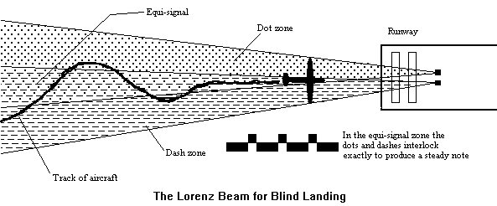
Notes:
The Lorenz Blind Landing system was developed by Dr. E. Kramar of the German company Lorenz. It had been used since the mid-1930s to enable both military and civilian aircraft of many countries, including Britain, to land at night and in poor visibility. It consisted of two interlocking radio beams which overlapped over the intended runway. One signal consisted of Morse dots, the other of dashes. They were so timed that when receiving both signals at the same time, a steady tone was heard. When out of this area, known as the equi-signal, the pilot knew what direction to steer to regain track depending on whether he heard dots or dashes.

Slide 20
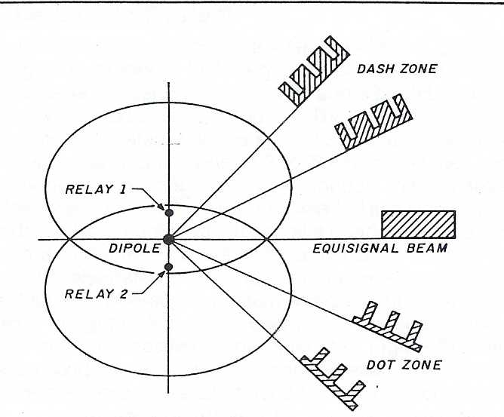
Notes:
Initially, to produce the overlapping beams a vertical dipole antenna was errected at the end of a runway. It operated on pre-set frequencies between 30 and 33.5 MHz, was modulated by a 1150 Hz tone, and had a power output of 500 watts. On either side of the antenna were vertical reflectors cut open at their centers. Relays at this point enabled the reflectors to be alternately switched in and out, creating two beams. By using a motor-driven cam switch, one beam could be the Morse dot, the other the dash. The beams intersected over the intended runways.

Slide 21
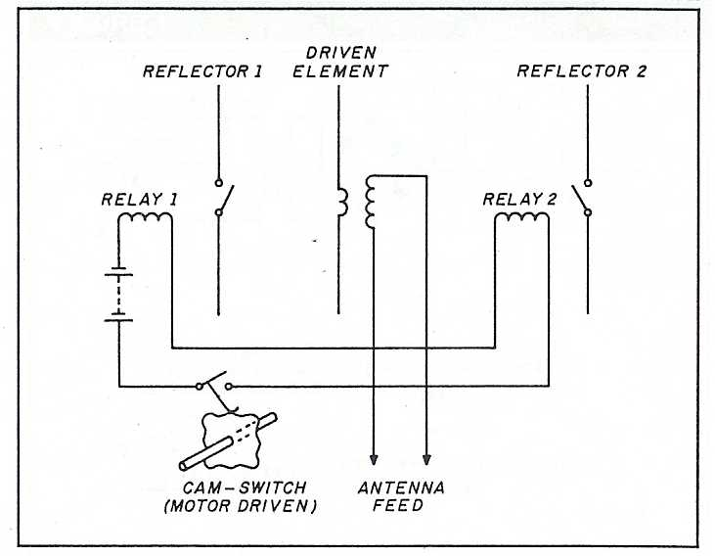
Notes:
This diagram illustrates the cam-switching for the reflectors. When the relays are not energized, the right-hand reflector is operational. When the relays are energized the left-hand reflector is operational. The transmitter produces a steady carrier, but by cutting the cam correctly, dots and dashed can be produced from the two antenna arrays (driven element and reflector). Note that in the diagram, the cam is not shown correctly.
The beams overlapped to produce a 3 degree wide approach pattern.
Had yagi theory been better understood at the time, it could have been possible to switch the relay in and out at a point other than the center of the reflector, and use the element as a director as well.

Slide 22
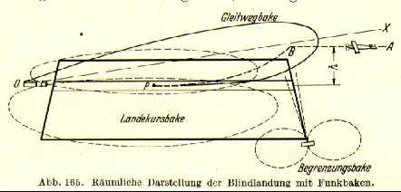
Notes:
Two additional transmitters were used to indicate distance from the runway. At 3 km a transmitter on 38 MHz sent a lower modulation note. At 300 meters from the runway a second transmitter broadcast a higher tone. These systems also operated a light to give a visual indication of distance to the runway. This was backed up with an S meter to indicate signal strength of the main beams.

Slide 23
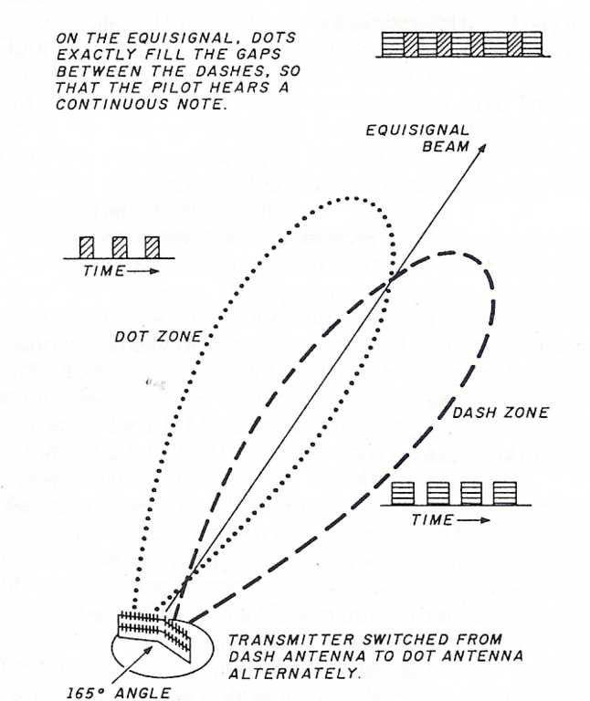
Notes:
In 1938, with war imminent, Telefunken developed a much larger system. It used a 50 watt transmitter operating between 30 and 33.3 MHz. The antenna array was 30 meters high, and 90 meters long, and revolved on a circular track. This framework supported two eight-element wire dipole/reflector combinations. The arrays were at an angle of 165 degrees to each other (looking from the top). From this “broken neck” appearance, “geknickten” in German, came the code name “Knickebein”.
The equi-signal zone of this antenna was just 0.6 degrees wide.

Slide 24
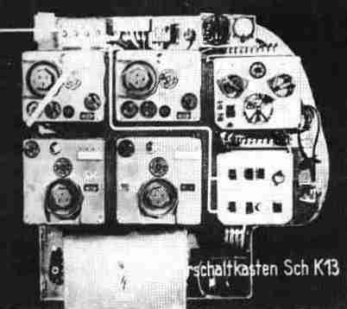
Notes:
Avionics fit of a WWII Luftwaffe bomber.

Slide 25
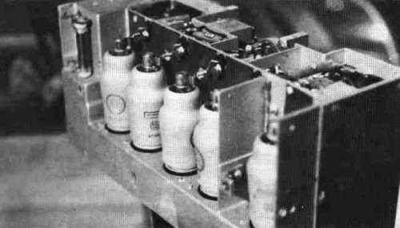
Captured German E Bl 2 Receiver
Five high gain pentode tubes gave it unusual sensitivity – key to its true function.
Notes:
The EBL 2 was an improved version of the E Bl 1 receiver that Jones reviewed.

Slide 26
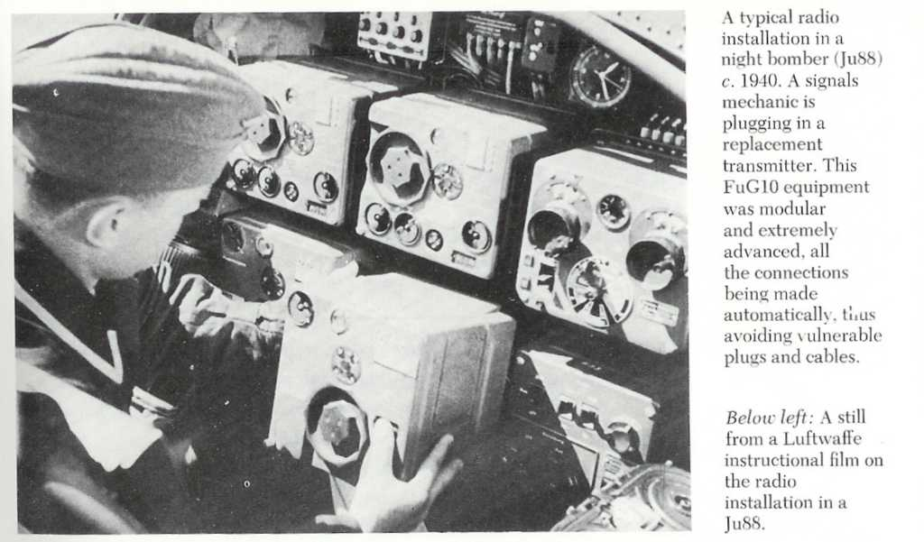

Slide 27
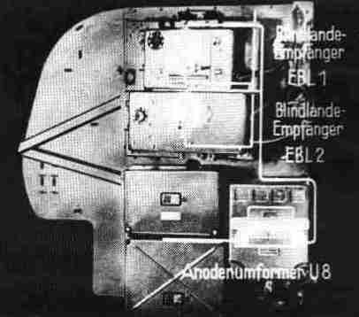
Notes:
Another view of the instrument panel of a German bomber, showing both the EBL 1 and EBL 2 “blind landing receivers”.

Slide 28
See notes
Notes:
On 5 June 1940, an ULTRA intercept (ULTRA was the codename assigned to information gained from the breaking of German cyphers, enabling messages to be de-coded) described the Cleves Knickebein as being confirmed, and gave a location in England. Jones correctly interpreted this as a report from a reconnaissance aircraft confirming the direction of the beam from Cleves in western Germany. Just to be sure however, a search party was dispatched to the named location to look for a hidden transmitter. Much to the disappointment of the local Bobbies however, no spy was found!

Slide 29
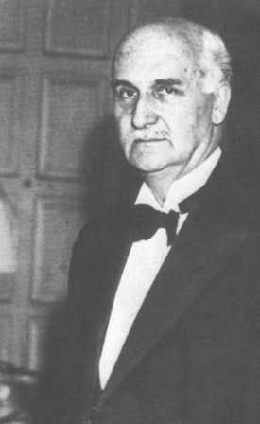
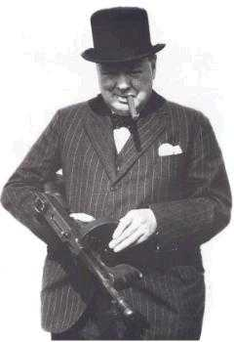
“There seems to be some reason to suppose that the Germans have some sort of radio device with which they hope to find their targets.”
Professor Lindemann
“This seems most intriguing and I hope that you will have it thoroughly examined.”
Prime Minister Winston Churchill
Notes:
Suspecting now that the Lorenz receivers were the mysterious Knickebein, Jones briefed Lindemann. Due to the weak state of the British night defences, and the resulting vulnerability of industry to night bombers, any advance in night-time navigation was important enough to report to the Prime Minister. He drafted a note to Churchill, writing “There seems to be some reason to suppose that the Germans have some sort of radio device with which they hope to find their targets.” Churchill initialed the note and sent it to the Air Minister, adding “This seems most intriguing and I hope that you will have it thoroughly examined.”

Slide 30
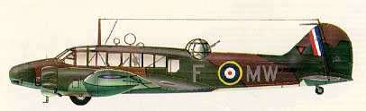
Avro Anson
“Knickebein (Kleve) 31.5”
“VHF. Knicke 54°38’7” N, 8°56’8” E, 51°0’30” N,Eqms.,
Stollberg 30 mc/s. Kleve 51°47’ N, 6°2’ E, 55N, 2° Eqms., 31.5 mc/s.”
Notes:
A committee was formed to investigate Jones’ theory. Three Avro Ansons were fitted with Halicrafters S37 receivers and flown by pilots trained in the Lorenz system. Rowley Scott-Farnie, G5FI had calculated that the Germans were most likely to use 30, 31.5 and 33.3 MHz. Sure enough, a few days later a scrap of paper was recovered from a crashed Luftwaffe bomber. It read “Knickebein (Kleve) 31.5”.
On 20 June a Heinkel was shot down. The radio operator had bailed out, and had torn his notebook to shreds on landing. He was actually burying the pieces when he was captured. RAF Intelligence pasted them back together and forwarded them to Jones. They read “VHF. Knicke 54°38’7” N, 8°56’8” E, 51°0’30” N,Eqms., Stollberg 30 mc/s. Kleve 51°47’ N, 6°2’ E, 55N, 2° Eqms., 31.5 mc/s.”
This seemed to confirm the existence of another Knickebein installation at Stollberg and in Schleswig-Holstein. It also confirmed Scott-Farnie’s guess about the frequencies. But after two flights, the Ansons had failed to detect any transmissions!

Slide 31
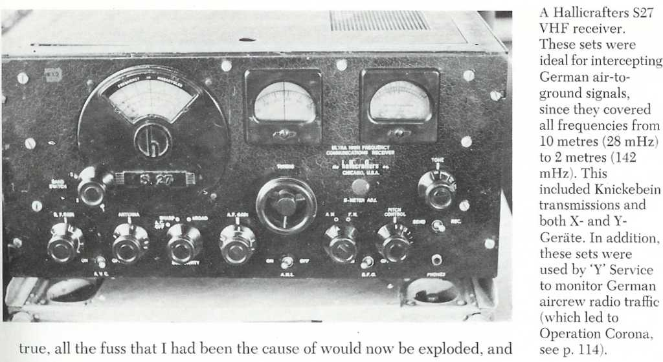
Notes:
Hallicrafters S27 VHF receiver.
The Hallicrafters S27 was designed in 1940 and covers 27 Mcs through 143 Mhz for the reception of AM, CW and FM signals using three bands. Its original cost was $US 175. Key features of the design were the use of mil-spec components and wiring, no electrolytic capacitors, and heavy duty chassis with strong internal bracing. The tuner is a separate, removable chassis, and uses acorn tubes. Specifically, the set incorporates the following : an IF of 5250 Kc; a Foster-Seely FM discriminator; a switchable 'narrow' and 'broad' IF bandpass; and a push-pull 6V6 audio amplifier stage. Another variant of the receiver, the S27B, was made between 1940 and 1941. Its frequency range covered 36 to 165 Mcs. Production of the S27 continued from 1940 to 1943 when it was replaced by the by S-36. S-36/36A began production in 1942 and covered 27.8 to 143 Mcs. From an electrical viewpoint, the replacement model was virtually identical except for some tube changes in the audio section. Many S27's were used during World War II as countermeasures receivers. The S27 used aboard HMCS HAIDA was known as the 'Headache Receiver'.

Slide 32
See notes
Notes:
Was Jones wrong after all? Many thought so, including Sir Henry Tizard, Air Chief Marshal Dowding, and Air Chief Marshal “Bomber” Harris. Other military and scientific people began to wonder if Jones had gone too far in questioning conventional scientific wisdom. Then, suddenly, Jones was summoned to a meeting at Number 10 Downing Street.
Thinking that the message was one of Scott-Farnie’s practical jokes, Jones arrived half an hour late to find the meeting already in progress. A roomful of talent confronted him. In addition to Churchill and Lindemann, there was Lord Beverbrook, Sir Archibald Sinclair (the Air Minister), Sir Cyril Newall (Chief of Air Staff), Sir Henry Tizard, Watson-Watt, and the Commanders of Fighter Command and Bomber Command among others. Jones apologized to Churchill and took his seat. An argument was taking place – did the beams exist or not? Jones soon realized that no one knew as much about the matter as he did. Suddenly Churchill snapped a question at him. Feeling he couldn’t answer it out of context, Jones said “Would it help, sir, if I told you the story from the start?” Churchill seemed somewhat taken aback, but then replied “Well yes, it would.”

Slide 33
“.. Although I was not conscious of my calmness at the time, the
very gravity of the situation somehow seemed to generate the steady
nerve for which it called. Although I was only 28, and everyone else
around the table was my senior in every conventional way, the threat
of the beams was too serious for our response to be spoilt
by nervousness on my part.”
Notes:
For the next 20 minutes Jones outlined his evidence. As he later recalled “.. Although I was not conscious of my calmness at the time, the very gravity of the situation somehow seemed to generate the steady nerve for which it called. Although I was only 28, and everyone else around the table was my senior in every conventional way, the threat of the beams was too serious for our response to be spoilt by nervousness on my part.”

Slide 34
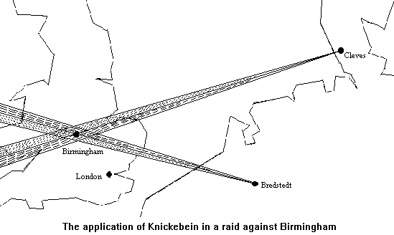
Notes:
Jones explained that he believed the antennas for the two beams were located 400 km apart and rotatable so as to select any target. A pilot would fly along one beam, adjusting as required for drift. When near the target, he would tune in the intersecting beam. Once its dashes merged into the equi-signal, the bombs were released. Accuracy was sufficient for a factory to be attacked at night.
When he finished, the group seemed incredulous. Sir Henry Tizard demanded to know why the Germans should use a beam at all, assuming such a thing were possible. He pointed out that RAF pilots found their targets using conventional navigation techniques (actually they usually missed by miles). Others around the table expressed doubt in Jones. Churchill seemed convinced however, and when he asked what should be done, Jones replied that the first step was to confirm the existence of the beams by flying along them. Once they had been confirmed, suitable false beams could be created to jam them. With a typical “Let this be done at once!”, Churchill then turned and tore a strip off the Air Ministry for their tardiness!
Jones didn’t realize it at the time, but his analysis was almost exactly correct – extremely remarkable considering that this complete description came about entirely by means of scientific intelligence.

Slide 35
See notes
Notes:
Elated at having convinced the PM, Jones rushed off to a meeting with the Director of Signals, Air Commodore Nutting, to discuss the possibility that the Germans could exploit pulse techniques as navigation aids. Also in attendance was T. L. Eckersley, and, predictably, conversation soon turned to Knickebein. Eckersley dropped a bombshell – he didn’t believe that signals in the 30 MHz range could bend round the Earth! But what about his calculations Jones pointed out? Oh those! Eckersley indicated that those were purely theoretical – what possibly could happen, but not really something that happened in practice!
The Ansons had failed to find any beams on their previous flights, and another sortie was scheduled to launch that evening. The Deputy Director of Signals indicated that if Eckersley, the world’s greatest expert on propagation, didn’t believe the signals could travel the distance, then why waste any more time searching for these beams? He actually picked up the telephone to cancel the flight, but Jones stood his ground! Pointing out that Eckersley had contradicted himself, Jones also reminded everyone that Churchill himself had ordered the search for the beams. He told the Deputy Director of Signals that if this evening’s flight were cancelled, he would…

Slide 36
“… jolly well let the Prime Minister know who had countermanded his orders!”
Notes:
“… jolly well let the Prime Minister know who had countermanded his orders!”
Not surprisingly, the Deputy Director backed down!
As chair of the meeting, Air Commodore Nutting then demanded “And what do we do if we find the beams?” Quietly Jones whispered to Rowley Scott-Farnie “Go out and get tight!” (drunk)

Slide 37
“Had I, after all, made a fool of myself and misbehaved so spectacularly in front of the Prime Minister? Had I jumped to false conclusions? Had I fallen for a great hoax by the Germans? Above all, had I arrogantly wasted an hour of the Prime Minister’s time when Britain was about to be invaded or obliterated from the air?”
Notes:
Dr Jones went home to spend one of the most miserable nights of his life. Later he wrote: “Had I, after all, made a fool of myself and misbehaved so spectacularly in front of the Prime Minister? Had I jumped to false conclusions? Had I fallen for a great hoax by the Germans? Above all, had I arrogantly wasted an hour of the Prime Minister’s time when Britain was about to be invaded or obliterated from the air?”

Slide 38
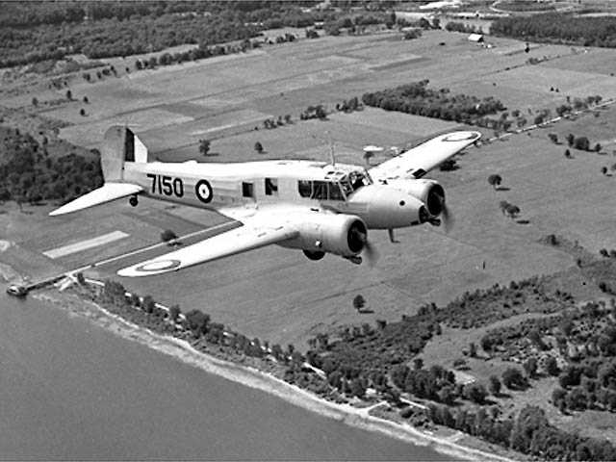
Notes:
It was a clear summer June evening as the Avro Anson climbed into the sky over Huntingdon and Lincoln that night. The crew had not been briefed on Knickebein, but merely instructed to search for Lorenz type signals. Suddenly they heard dots on 31.5 MHz on the Hallicrafters receiver! The aircraft swung to the north. After a few minutes a steady tone, and then dashes. After plotting this beam, the crew continued the search. Later that evening another beam was discovered. When plotted later on a map, they intersected over the Rolls Royce factory in Derby that produced aircraft engines for the RAF!
The meeting in Air Commodore Nutting’s office re-convened the next day. When informed that not one, but two beams were discovered the previous evening, the group was jubilant! In the middle of the revelry Scott-Farnie reminded Jones of what he had said the day before. So the two of then ducked out to the pub across the road to celebrate!

Slide 39
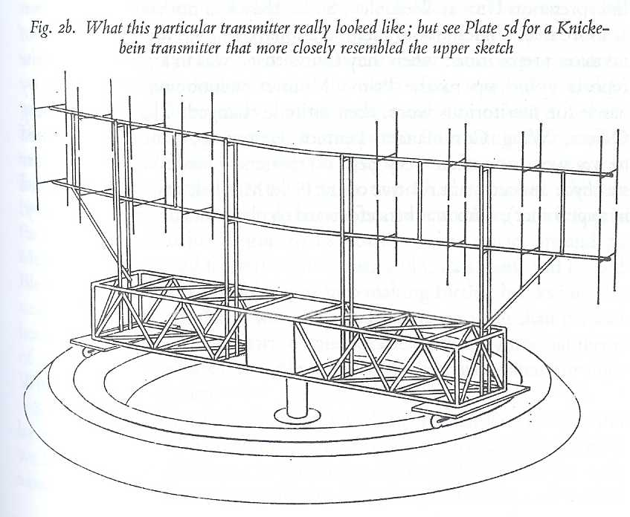
Notes:
As an aside, this is what the rotatable antenna array for the Knickebein looked like. Note the vertical stacked dipoles with reflectors behind them, in two separate arrays offset by 165 degrees.

Slide 40
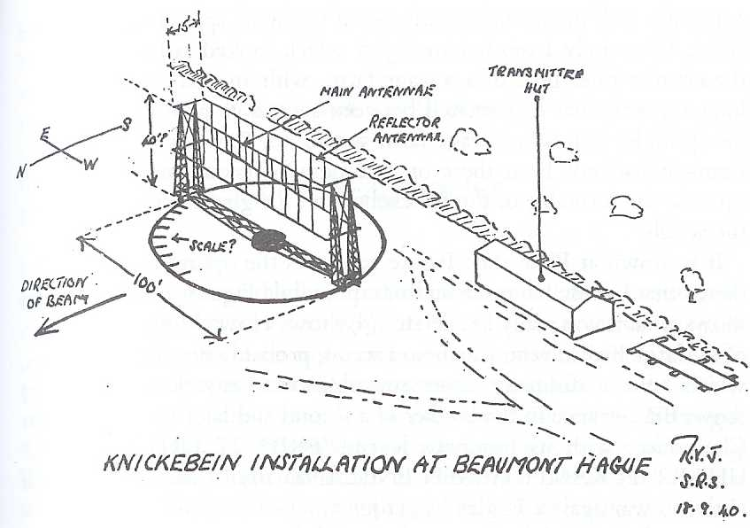
Notes:
Drawing of the Knickebein installation near Beaumont Hague, drawn by RV Jones himself. Wouldn’t your Homeowners’ Association have a fit if you put this out in your back yard for 10 meters!

Slide 41
See notes
Notes:
So the beams had finally been found – now it was necessary to do something about them. First of course, a suitable codename had to be selected. Considering the trouble the beams had caused, “Headache” seemed an appropriate name!
There appeared to be no transmitters available to jam the German signals until someone remembered that diathermy sets, used by hospitals to cauterize wounds, generated RF near the desired frequencies. A doctor specializing in Diathermy was contacted, and he agreed to help. He was given some money, told to buy a uniform, and go round to all the hospitals and quote “pinch the diathermy sets”! This was done, and the sets were quickly converted into 150 watt noise jammers. Many were installed in local police stations with instructions for the on duty Bobby to switch them on whenever the air raid alarm was sounded. It appears that they had little effect on the accuracy of the beams, but they did let the Luftwaffe aircrews know that the British were aware of the beams, and therefore possibly reducing their confidence in the system.

Slide 42
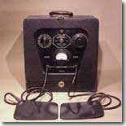
Diathermy set

Slide 43
See notes
Notes:
Meanwhile purpose built jammers were being developed by the countermeasures section at the Telecommunications Research Establishment at Worth Maltravers (don’t you just love British placenames!) under Dr. Robert Cockburn. The Lorenz system was installed at several British airfields before the war, so these transmitters were modified to jam the Knickebein signals. As an antidote to the “Headache” beams, the jammers were codenamed “Asprin”! Eventually 28 such transmitters were built, some mounted on trucks.
A special organization to coordinate jamming efforts was established. Under the command of Wing Commander Addison, 80 Wing used receivers mounted atop the 240-foot high Chain Home radar towers to give initial warnings of beam activity. Once the transmissions were detected, this information was passed to Fighter Command Headquarters at Bentley Priory (there’s those British names again!).

Slide 44
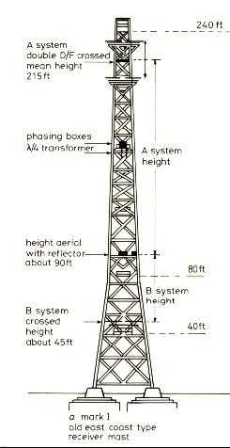
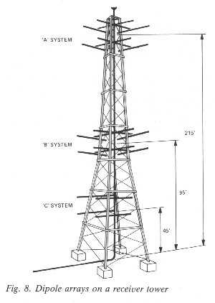
Notes:
Chain Home radar receive tower. The system operated in the frequency range of 20 – 30 MHz, at a peak power of 350 (later 750) kW. It used two separate arrays of 3 or 4 towers, one for transmitting, the other for receiving. The Headache receivers were located at the top of the receive towers. Jones himself spent a night atop one of the towers, listening to signals that Eckersley had said could not be received by bombers at 20,000 feet. In fact, the signals were quite audible inside a partly buried bunker with a wet shingle roof!
By comparing the signals received at the various towers (ie: dots or dashes), the general location of the beams could be determined. Anson bombers were sent up to plot the precise axis of the beams. Appropriate jammers were then activated, flooding the airwaves with powerful dashes. Luftwaffe pilots flying in their own dash zones would turn to find the equi-signal zone, only to continue to hear dashes. They would fly in large circles in a vain attempt to find their way. Apart from a handful of pre-war pilots, most Luftwaffe pilots lacked the necessary nighttime instrument flying skills to work through the jamming – the Luftwaffe was a tactical air force that stressed daytime operations. Some aircrew became so disoriented that they bailed out, believing their entire electrical systems to be haywire! Most importantly, the accuracy to hit critical targets such as aircraft factories was not achieved.

Slide 45
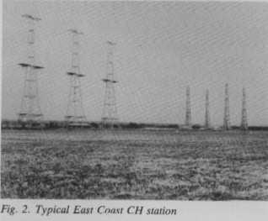
Notes:
CH radar installation. Transmit towers are on the left, receive on the right.

Slide 46
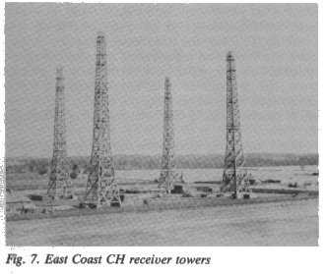
Notes:
Another view of the receive towers – the towers are wood, but run wires up the sides, and this would make a great 4 square for 160m!

Slide 47
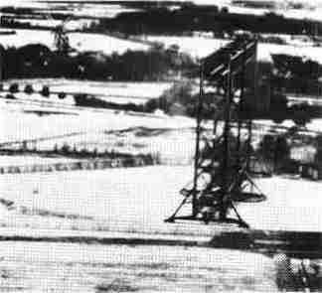
Notes:
A picture of a Knickebein antenna similar to the one sketched by Jones.
Detection of the beams was made much easier because of poor signal discipline on the part of the Germans. The beams were left on much longer than necessary, sometimes all day. This was possibly for operator training, but the antennas could easily have been trained towards the interior of the continent, preventing the British from receiving them.

Slide 48
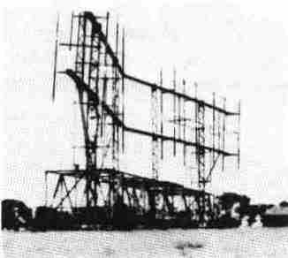
Notes:
Eventually the Germans began to try counter-countermeasures to the Aspirin jammers. The beams would be switched on at the last moment, or would be aligned on spoof targets, being trained onto the real targets after the British had activated the jammers in the wrong area. This was not terribly successful – it made it very difficult for the bomber crews to find the beams themselves.

Slide 49
See notes
Notes:
Another British countermeasure to the Knickebein beams was developed, but cancelled when it became evident that the Aspirin jammers were sufficient. It was really a deception repeater – Knickebein signals were to be received at one location, sent by landline to a distant transmitter, and sent back out over the air. This would cause the beams to appear to bend. Although never implemented, it gave rise to the myth that the British were indeed bending the beams. On one occasion a Luftwaffe bomber, by chance, jettisoned its load over Windsor Castle. The next day Group Captain Addison, responsible for the Aspirin jammers, received a phone call from a very irate Comptroller of the King’s Household, demanding to know why he had dared to bend the beams over Windsor Castle!
Another little-known British jamming effort was probably responsible for the accidental bombing of Dublin in the neutral Republic of Ireland by a single German bomber in May 1941. The RAF was aware of a system of 80 low frequency beacons over mainland Europe, used by aircraft for navigation. Operating between 200 and 500 KHz, these beacons radiated a continuous signal identified by its assigned frequency and CW callsign. By taking bearings on 3 or more beacons, a bomber’s position could be determined. The British used a similar technique, and at the beginning of the war all BBC transmitters were synchronized into groups on common frequencies to prevent German aircraft from using them for navigation.
The German beacons were countered in a very elegant manner…

Slide 50
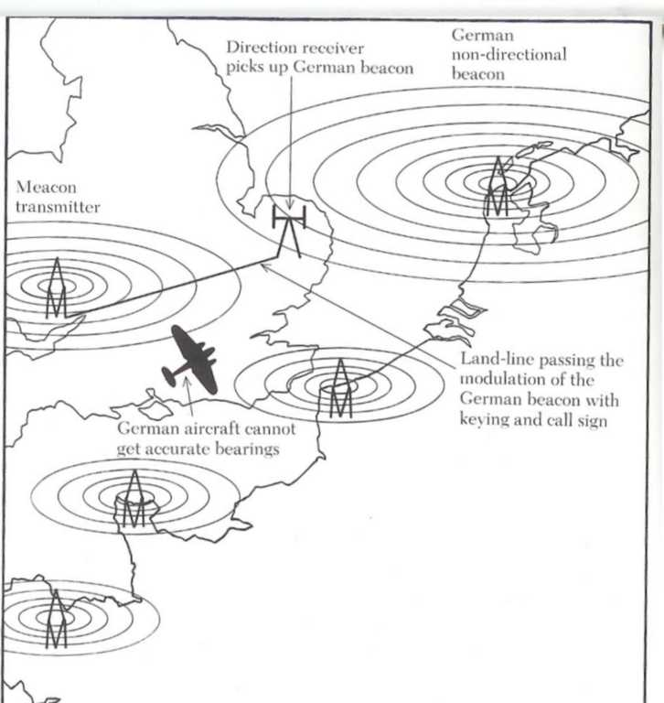
Meaconing
Notes:
Receivers with directional antennas on the south and east coast of England were tuned to the beacon frequencies. The received signals were sent by telephone line to counterfeit beacon transmitters, which re-radiated them on the same frequency. Changing callsigns had no effect, as the fake British transmitters were modulated by the original German signal. This “masking of beacons” became known as meaconing.
A later development was to intercept radio messages from German aircrews asking ground stations to take a bearing on the aircraft’s transmissions. The ground stations would pass the bearings to the aircrew, who would then plot them to fix the aircraft’s position. The British would key more powerful transmitters when the aircraft was to transmit, and the ground stations would receive the British station instead of the aircraft. The aircrew would then be passed wildly incorrect bearings. This all combined to make nighttime navigation a nightmare for Luftwaffe aircrews. Several were lost to accidents, and a handful actually landed at RAF airfields, believing themselves to be in Occupied Europe!

Slide 51
See notes
Notes:
In mid-August 1940 the Luftwaffe began an all-out bombardment of Britain. On the 13th of that month 20 night bombers attacked a Spitfire factory near Birmingham. What alarmed the RAF was the accuracy of the raid – despite the Aspirin jammers, eleven bombs struck the plant itself. Did the Germans have a new navigation system?
The telephone shattered Dr. Jones’ sleep early one morning in the first week of September 1940.
“We’ve got something new here! God knows what it is, but I’m sure it’s something for you!” The voice belonged to Professor Frederick “Bimbo” Norman, a cryptographer at Bletchley Park. The cryptographers had broken a German message that mentioned radio beams, including information that the beamwidth was 8 to 10 seconds of arc, or no wider than 20 meters at 320 km. Then came the electrifying term “X-Gerat”. Whatever X-Gerat was, it was being installed in bombers of Kampf-Gruppe 100, one of the Luftwaffe’s elite squadrons.

Slide 52
“Our community of Radio Amateurs in Britain was to prove an
invaluable reserve, both in Signals Intelligence and Signals proper,
as well as furnishing many of the staff for our rapidly increasing
number of radar stations.”
Dr. R. V. Jones
Notes:
Jones rushed the various intelligence agencies into action. Included in the British Signals Intelligence organization were the Voluntary Interceptors – a group of Amateur Radio operators who scanned the airwaves. In appreciation of their efforts, Jones wrote “Our community of Radio Amateurs in Britain was to prove an invaluable reserve, both in Signals Intelligence and Signals proper, as well as furnishing many of the staff for our rapidly increasing number of radar stations.”
It was an Amateur, Rowley Scott-Farnie G5GI, who reported to Jones in mid-September that intercept stations had detected German beam signals operating near 74 MHz in the Calais and Cherbourg regions. Because no known Luftwaffe receivers operated on those frequencies however, the British had first concluded that they were intended for the navigation of minelayers or motor torpedo boats. Ultra intercepts in September indicated their true purpose though, and revealed a wealth of technical details.

Slide 53
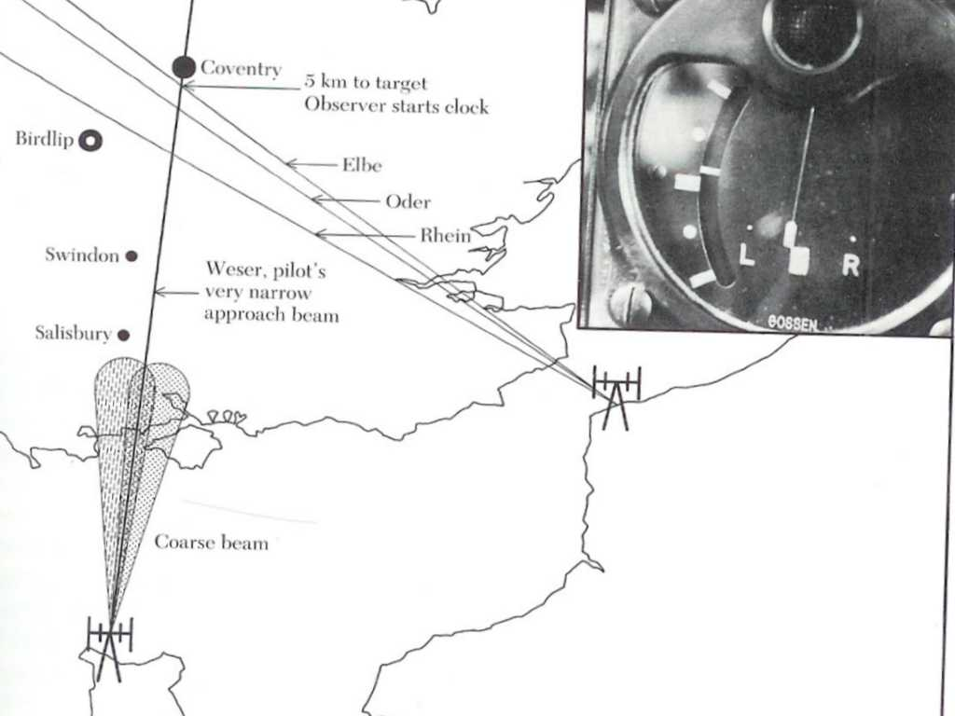
X-Gerate
Notes:
The system worked as follows: Heinkel 111 bombers of Kampf-Gruppe 100 would launch from Brittany and fly towards Cherbourg to intercept a course Lorenz-type beam. Superimposed on this coarse beam was a very fine beam codenamed Weser. The coarse beam was easy to find and permitted the pilot to gradually ease into the fine beam, only 20 – 30 feet wide. The signals were not monitored by ear, but used a “kicking” meter which indicated if the aircraft were left or right of equi-signal. The pilot was responsible for staying on course, and for maintaining a given speed and altitude.
The observer had a separate receiver tuned to the cross beams from Calais. He also had a kicking meter, and a bombing computer that resembled a large clock. On intercepting the first cross beam, named Rhein, the observer warned the pilot to pay careful attention to course, altitude and speed. On intercepting the second crossbeam, named Oder, the observer started the clock. The aircraft was now 30 km from the target. At 15 km the final cross beam, named Elbe, was intercepted. The observer pressed a control lever on the bombing computer, thereby giving it a very accurate ground speed. It used this to calculate when to automatically release the bombload. Accuracy was about 90 meters at 300 km, the most precise blind bombing system developed to date. It was so precise, that in calculating the azimuth to aim the beams, the Germans had to take into account that the Earth is not a perfect sphere, but is actually flattened near the poles. If not, the beams would have been off 275 meters over London.

Slide 54
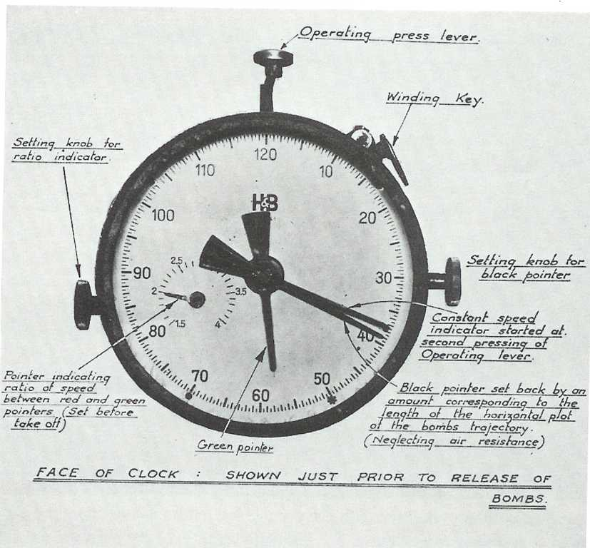
Notes:
Bombing computer

Slide 55
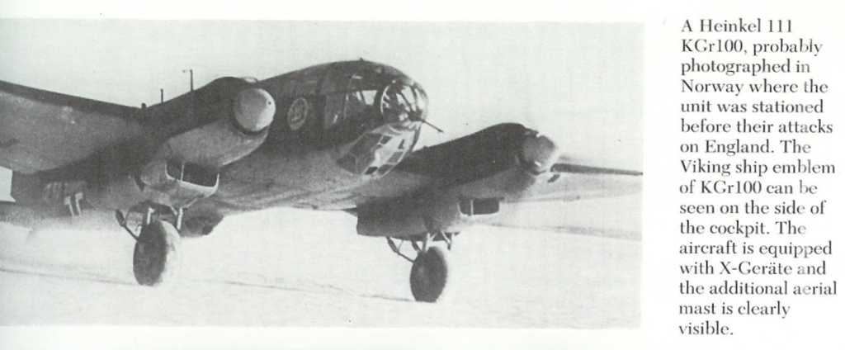
Notes:
In mid-October Kampf-Gruppe 100 introduced another innovation into night bombing, one that was later used quite extensively by the British. To enable bombers other than just X-Gerat fitted ones to attack accurately at night, the concept of pathfinders was developed. Kampf-Gruppe 100 bombers would mark the targets using incendiary bombs. Other bombers would aim for the resulting fires.

Slide 56
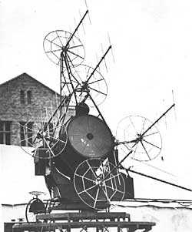
Notes:
Countermeasures to X-Gerat took two forms. The first was electronic. A number of army gunlaying radars, similar to the searchlight control radar shown here, were modified to jam the coarse and fine beams in the same manner as the Aspirin jammers. These were nicknamed “Bromide”, an appropriately stronger analgesic than Aspirin.
Note the Yagi antennas with screen reflectors. In this setup the 4 antennas around the searchlight were probably slightly off boresight. The operator would then aim the searchlight for equal echos from the target aircraft. I assume that the top antenna would be for ranging.

Slide 57
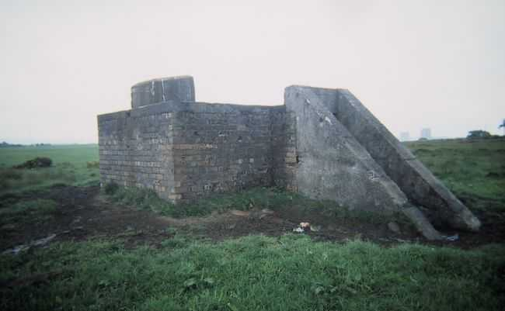
Control Bunker for “decoy fire city”.
Notes:
The second countermeasure was visual. Fires started by the pathfinder aircraft were extinguished as quickly as possible. Meanwhile, decoy fires were started in nearby empty fields in order to fool the other bombers into wasting their bombs on false targets. These decoys became quite elaborate as time progressed. They were manned by RAF enlisted men who controlled the setups from slit trenches and bunkers. During one particularly heavy raid, the Commanding Officer of one group called to see how they were. Apparently, their comments were not suitable to be recorded in the squadron history! Fortunately however, none of the men so employed were lost during the war.

Slide 58
“These it transpired, were due to bad
measurement of the frequencies of the German
beams on the part of the countermeasures
organization, a feature that was to plague us
through the whole battle. The fault in this case
probably lay not with the observers, but with the
calibration of our receivers which were not up
to the German standard of precision.”
Notes:
The electronic countermeasures appeared to have no effect initially. At first it was believed that the Bromides were set to the wrong frequency. Through a combination of incredible code-breaking by Bletchley Park, and brilliant analysis by Jones, it was usually possible to determine the beam frequencies, target, time of the first bomb drop to within 10 minutes, exact speed of the bombers, their line of approach and their altitude to within 200 meters several hours ahead of the attack! Jones discovered that the monitoring services were ignoring his recommendations as the the operating frequency however, as it did not agree with their measured results. Never one to mince his words, Jones bluntly pointed out that British receiver calibration was not up to the high German standard of precision. His findings were accepted.
Still, the jamming did not seem to be effective. Jones began to wonder if the only use the Duty Air Commodore made of his recommendations was to win bets with the rest of the Command as to where the target would be that night!
The problem would be discovered, but not in time to aid the inhabitants of Coventry.

Slide 59
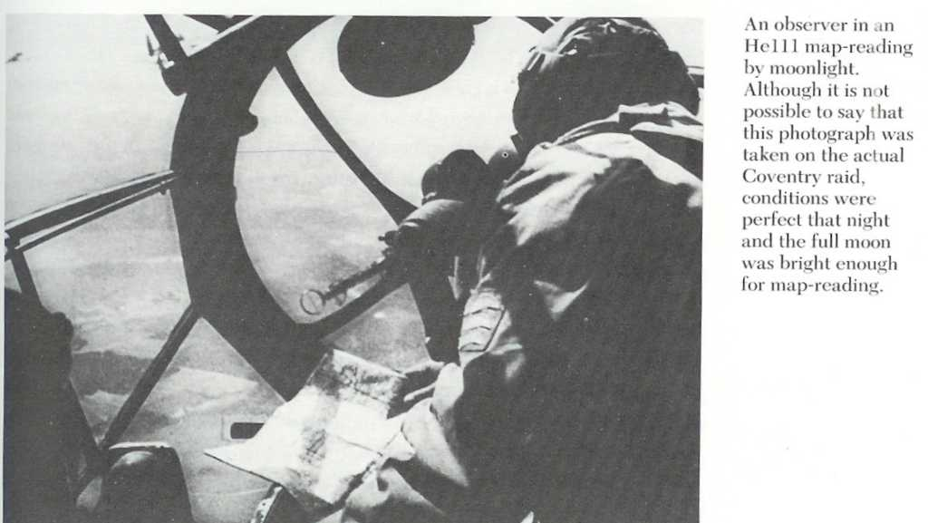
Notes:
On the night of 14/15 November 1940, the X-Gerat and pathfinding techniques worked to deadly perfection in a massive raid on Coventry. The 12 Heinkel 111s of Kampf-Gruppe 100 probably didn’t even realize that they were being jammed. Codenamed Moonlight Sonata by the Luftwaffe, 499 bombers dropped 150,000 incendiary devices and 503 tons of high explosives in a 10 hour period. The city was devastated. Seven important war factories were out of action for months. The city center was ablaze with over 200 fires. The city’s water and gas lines were smashed. When it finally ended, 554 men women and children lay dead in the rubble, and 865 others were injured.

Slide 60
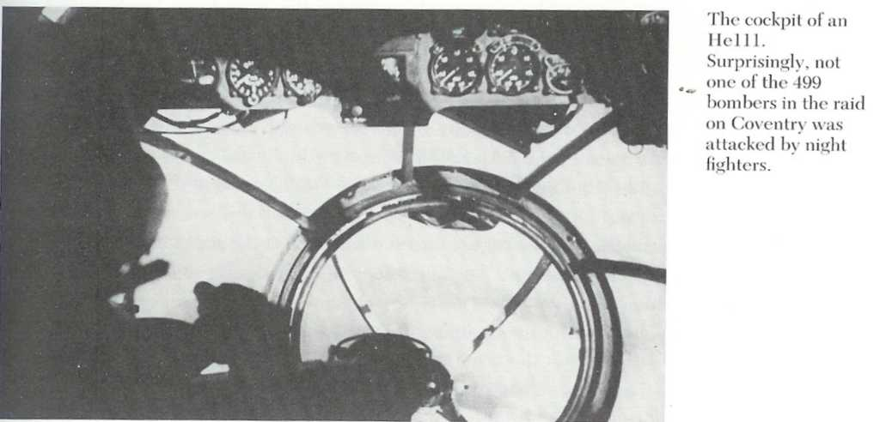

Slide 61
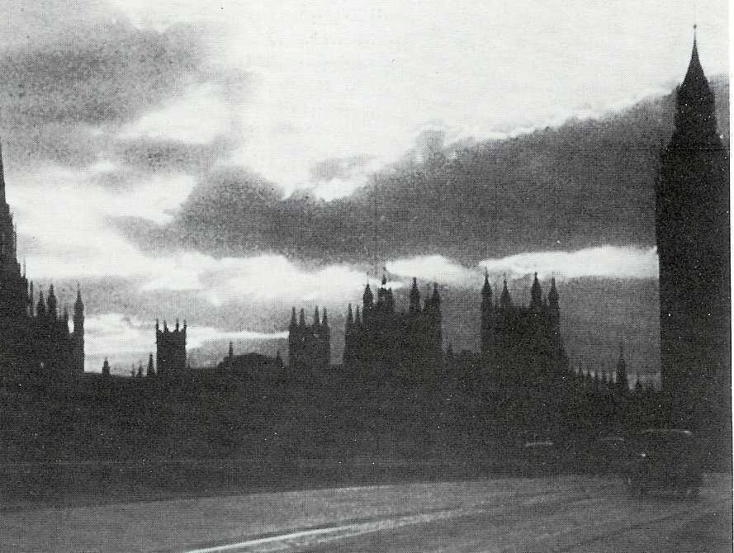
Notes:
View of London during the Blitz.

Slide 62
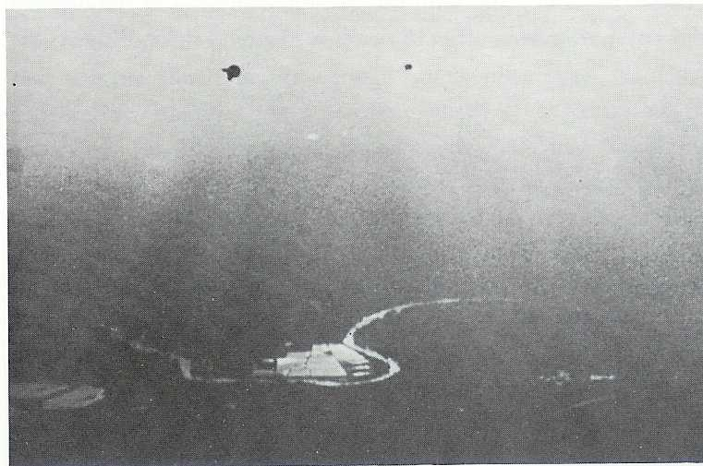
Notes:
The River Thames as seen from German bomber.

Slide 63
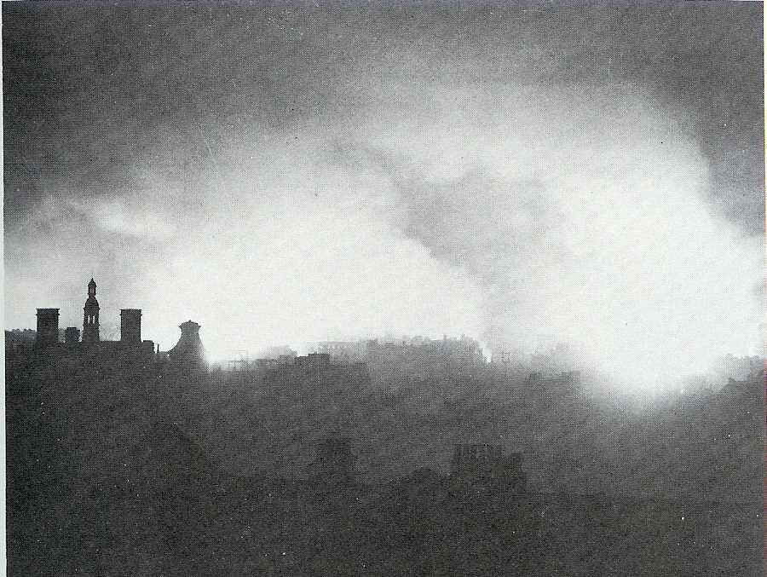

Slide 64
See notes
Notes:
The jammers had indeed been set on the correct frequencies, but the modulating tone had been set at 1500 hertz instead of the required 2000. Tragically for the inhabitants of Coventry, the opportunity to discover the proper frequency had been lost 8 days prior to the raid. A Heinkel 111 of Kampf-Gruppe 100 had crash landed on an English beach after running out of fuel. The crew thought that they were over Spain – they were the victims of the British meaconing of the beacon at St. Malo. A nearby army unit began salvage work on the wreck when a Royal Navy patrol boat arrived on the scene.

Slide 65
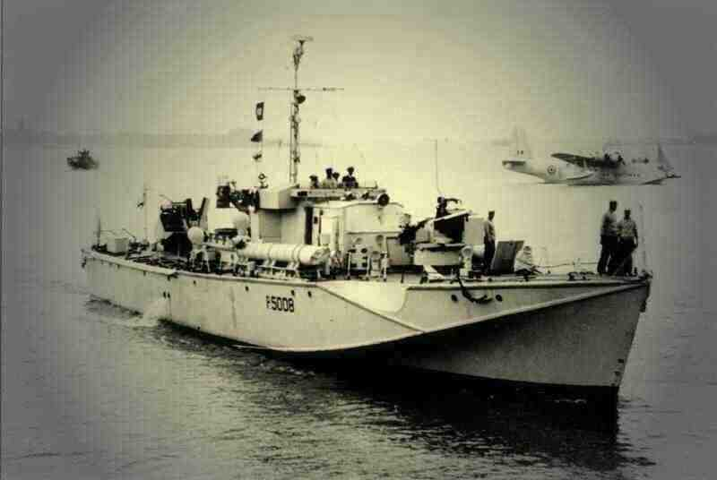
Notes:
The young lieutenant in command of the patrol boat claimed that because the wreck was partly in the ocean, the Navy was in charge of salvage efforts. Outranked, the soldiers had to back off. Incredibly, the patrol boat’s commanding officer then ordered the wreck towed into the ocean, where it promptly sank. The army eventually got the aircraft back up onto the beach, and the x-gerate, by now covered in silt and corrosion, was sent for analysis. The discrepancy in modulating tones was then discovered, two weeks too late for the people of Coventry.
Jones was angry and heartsick. After so much trouble was taken to get the difficult parts right, a slip-up had occurred because of a lack of attention to a seemingly trivial detail. He was further incensed when TRE offered the excuse that the modulation note had originally been 1500 Hz, but the Germans changed their filters to avoid the jamming. Jones countered this excuse by pointing out that if this had actually been the case, we would have heard the change in tone on the transmitted signal as well.
Eventually, enough of the Bromide jammers were produced with the correct modulation to effectively jam the X-Gerate system. Postwar analysis revealed that the decoy fires and the diversion of Kampf-Gruppe 100 aircraft to other missions were just as important in reducing the effectiveness of the bombing campaign.

Slide 66
See notes
Notes:
By the start of 1941, the night-bomber force of the Luftwaffe was still a potent force. Over 550 aircraft were available and although Knickebein had been neutralized and the jamming of X-Gerat was showing some effect, the night bombers were far from defeated. The British monitoring services had discovered new beam-like signals between 40 and 60 MHz. The Battle of the Beams was about to enter its third and final phase.
Ultra intercepts as early as June 1940 had mentioned Knickebein and Wotan installations being sited near each other. Knowing that the Germans sometimes used clever codenames Jones consulted an expert in German mythology, Professor Frederick Norman then working as a cryptographer at Bletchley Park. Known for his lightening quick mind, “Bimbo” gave his analysis instantly – Wotan was a one-eyed god – could the Germans be using a single beam system?
Known to the Luftwaffe as Y-Gerate or Wotan, the system was codenamed “Benito” by the British, as Musselini was the “one-eyed end of the Axis powers”! The task of defeating Benito was turned over to a team at the Telecommunications Research Establishment led by Dr. Robert Cockburn. Due to the complex nature of the signals, it was obvious that a visual indication of the waveform was necessary. By January 1941, the signals were being analyzed on oscilloscopes.
Benito was the most ingenious of the 3 beam systems, yet paradoxically it was the easiest to jam. A ground station in northern France transmitted a double signal between 42.1 and 47.9 MHz. One signal was for range, the other for bearing. The bearing signal employed a sophisticated Lorenz system. It gave not only a visual indication of being left or right of track, but could also control an auto-pilot that could maintain course far better than a pilot could.

Slide 67
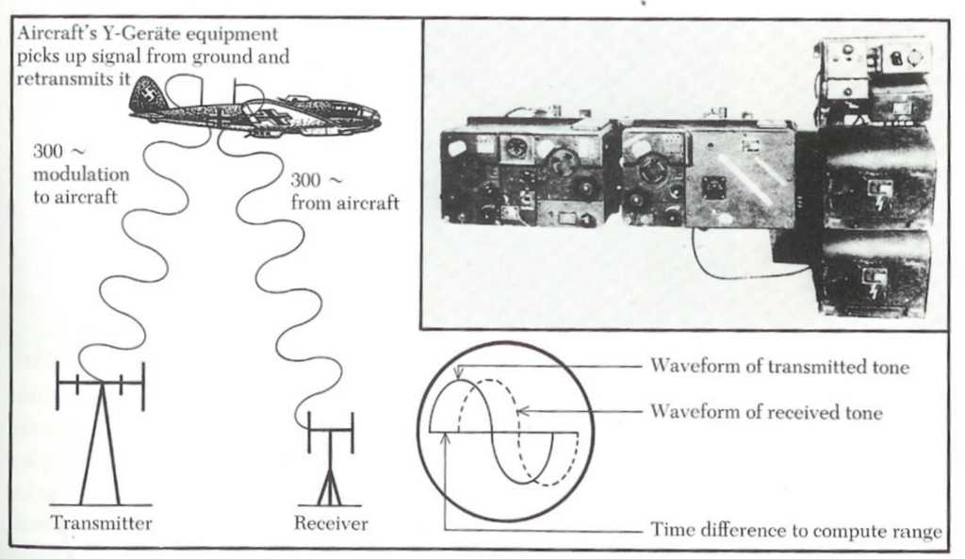
Notes:
The range signal was modulated by a constant 300 Hz tone. It was picked up by the receiver in the aircraft, and re-radiated on a frequency about 3 MHz away back to the ground station. The audio tone of the original signal was compared with that of the re-radiated signal from the aircraft, and displayed on an oscilloscope. The phase difference was measured, and this gave the transit time. From this the range could be determined. It was accurate to within 90 meters at 400 km. The entire system could also release the bombload by ground station control.

Slide 68
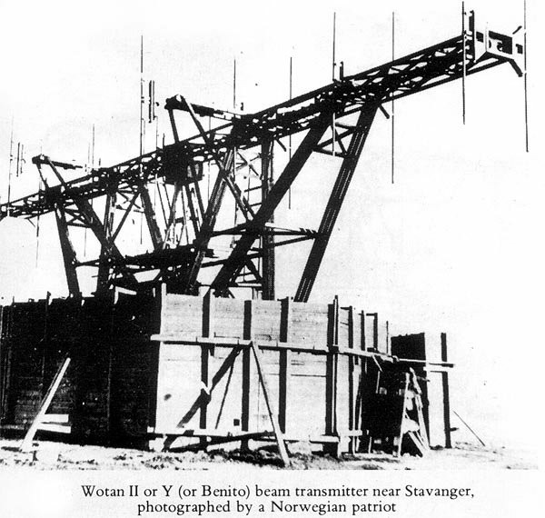

Slide 69
Flaws of the Y-GERATE
The aircraft was required to transmit.
The system was automatic and could be more easily deceived.
Only one bomber could be controlled at a time.
Notes:
Though sophisticated and ingenious Y-Gerate had 3 flaws:
Within 2 months of first identifying the Y-Gerate signals, the system was countered. It was done so subtly at first that the Luftwaffe did not realize it. A BBC receiving station in London picked up the ranging signal from the aircraft and sent it by landline to the dormant BBC TV station at Alexandra Palace.

Slide 70

BBC TV station
at Alexandra Palace,
London.
Notes:
The powerful transmitter sent the already re-radiated signal back to the aircraft on the frequency used by the ground station, only to have it re-radiated again. The German ground station would then receive a signal which had been re-radiated twice. This of course caused phase differences that were anything but what they should have been. As a result, range ambiguities were created. Jones advised that the power on the jamming transmitter be gradually increased over the first few nights so that the Germans would not immediately be aware that the system was being interfered with.
By chance, the jamming began on the very first occasion that Y-Gerat was employed operationally. Even at low power the jamming caused serious errors. As the cause was not readily apparent, a great deal of mistrust was created between the aircrew and ground controllers, much to the merriment of the eavesdropping British. Each accused the other of having defective equipment, and the aircrew soon resorted to other, less accurate, navigation techniques. As the power at Alexandra Palace was increased over the next several days the Germans gradually realized that it was the British causing the problems. Psychologically, Jones’ tactic paid off. From then on, whenever something went wrong, it was the fault of the British. The Germans suspected the British of causing all sorts of havoc even when they were not involved. For example, the Luftwaffe realized that the British could spoof the ground controller’s instructions to the aircrew. Even though it was never done, the resulting suspicion caused all sorts of problems. Here’s one German pilot trying to use Y-Gerat…

Slide 71

Notes:
Boy is he pissed off – shaking his fist at the radio! Is that an MFJ SWR analyzer in his other hand?

Slide 72
Notes:
Much later Dr. Jones learned that the full designation of Y-Gerat was in fact Wotan II, and that of X-Gerat was Wotan I, it being very much a multi-beam system. The truth was that the god’s name had nothing to do with Y-Gerat’s other codename! Dr. Jones later admitted that had he known this from the start, he might have taken much longer to discover the real method used by the new system!

Slide 73

Notes:
By March 1941 the nighttime Blitz was almost over. The three Luftwaffe beam systems had been countered, and new RAF night fighters with improved airborne intercept radars, such as the Mosquito shown here, were taking an increasing toll of German bombers. Just as the boffins were wondering what new surprise would be thrown their way, the German bombers all flew east – to the Soviet Union.
The Battle of the Beams was the first of its kind to be fought. Given the abysmal state of British night defences throughout 1940, the scientists, engineers and Amateur Radio operators who detected the beams and then developed countermeasures provided the only shield over the British Isles.
How bad could it have been without the countermeasures? In the words of Dr. R. V. Jones:

Slide 74
How bad could it have been without the electronic countermeasures?
In the words of Dr. R. V. Jones…
“If one thinks of what could have happened if with Knickebein, all the German Air Force could have bombed accurately. Well, we saw what happened when things went wrong as at Coventry… That could have happened every night.”

Slide 75
See notes
Notes:
Several lessons and conclusions can be drawn from the Battle of the Beams, still applicable today even more than 60 years later. In no particular order…

Slide 76
Lessons Learned…
Timely intelligence is vital in Electronic Warfare – Delays cost lives.
Notes:
Timely intelligence is vital in Electronic warfare – Delays cost lives.
The delay in learning the modulation frequency of the X-Gerate caused the wrong settings to be applied to the Bromide jammers. This resulted in hundreds of dead and injured in the raid on Coventry.

Slide 77
Lessons Learned…
Timely intelligence is vital in Electronic warfare – Delays cost lives.
Don’t always believe the scientists!
Notes:
Don’t always believe the scientists!
While it is vital that the scientists and military have a close working relationship, we must never forget that scientists can be wrong at times. Despite being recognized as one of the world’s pre-eminent propagation experts, Eckersley really didn’t understand VHF propagation. Had Jones backed down when Eckersley said that the Knickebein signals could not be received in Britain, countermeasures to it would have been delayed.

Slide 78
Lessons Learned…
Timely intelligence is vital in Electronic warfare – Delays cost lives.
Don’t always believe the scientists!
Don’t transmit if you don’t have to.
Notes:
Don’t transmit if you don’t have to.
This is a basic premise of EW. By transmitting you give away your location, type of emitters and therefore possibly the platform, and you make it much easier for an enemy to develop countermeasures to your equipment. Example – Knickebein countermeasures made much easier by poor signal discipline on the part of the Luftwaffe.

Slide 79
Lessons Learned…
Timely intelligence is vital in Electronic warfare – Delays cost lives.
Don’t always believe the scientists!
Don’t transmit if you don’t have to.
Countermeasures don’t have to be electronic.
Notes:
Countermeasures don’t have to be electronic.
The decoy fires to mislead the bombers following the pathfinders proved effective in countering X-Gerat.

Slide 80
Lessons Learned…
Timely intelligence is vital in Electronic warfare – Delays cost lives.
Don’t always believe the scientists!
Don’t transmit if you don’t have to.
Countermeasures don’t have to be electronic.
Sometimes wrong assumptions lead to the right conclusion.
Notes:
Sometimes wrong assumptions lead to the right conclusion.
If you discover part way through a problem that your initial assumptions were not correct, it may still be possible to draw the proper conclusion. Jones believed that the codename Wotan indicated a single beam system. The codename had nothing to do with the way the system operated, but his deductions were still correct.

Slide 81
Lessons Learned…
Don’t blindly trust black boxes and…
Don’t automatically assume the other guy has an equipment failure if something isn’t working.
Notes:
Don’t blindly trust black boxes and…
Don’t automatically assume the other guy has an equipment failure if something isn’t working.
Just because things aren’t working, don’t assume that it is the other guy. You might be the victim of a clever enemy! Example – bickering between the aircrews and ground controllers caused by jamming the Y-Gerate.

Slide 82
Lessons Learned…
Don’t blindly trust black boxes and…
Don’t automatically assume the other guy has an equipment failure if something isn’t working.
Use all available means to fix your position.
Notes:
Use all available means to fix your position
Always take every opportunity to determine exactly where you are. Even today, GPS can malfunction, or can be jammed. Example: the bomber that crash landed in England thinking it was over Spain because of meaconing.

Slide 83
Lessons Learned…
Don’t blindly trust black boxes and…
Don’t automatically assume the other guy has an equipment failure if something isn’t working.
Use all available means to fix your position.
When trying to salvage an aircraft on the beach, don’t tow it into the ocean!

Slide 84


Slide 85


Slide 86


Slide 87

Luftwaffe Ju 88 bomber

Slide 88


